Slide 1


LANGUAGE TRANSLATOR WITH USING PYTHON.
SREEJA (192210547)
AFSIN (192220078)
DEPARTMENT OF COMPUTER SCIENCE AND TECHNOLOGY
PYTHON PROGRAMMING FOR CRAFTING WINDOWS APPLICATIONS
CODE : CSAO876
FACULTY : Mr. ARAVINDHAN

Slide 2
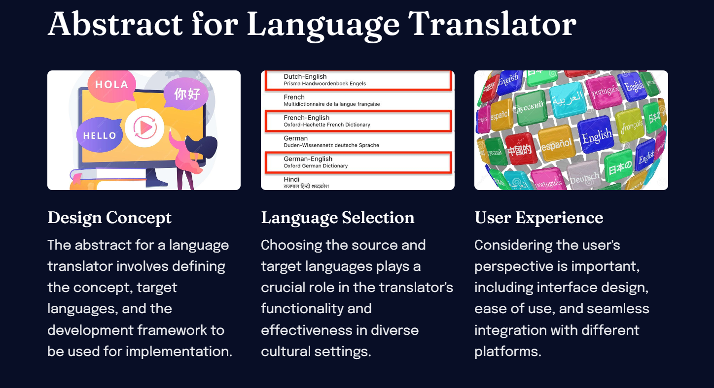

Slide 3
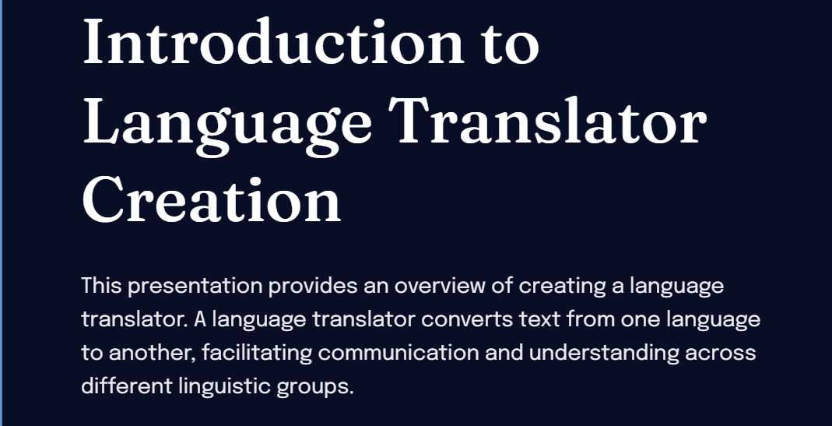
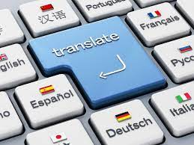

Slide 4
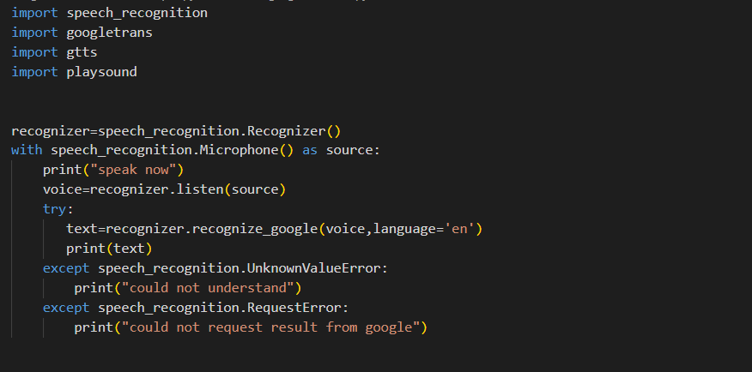
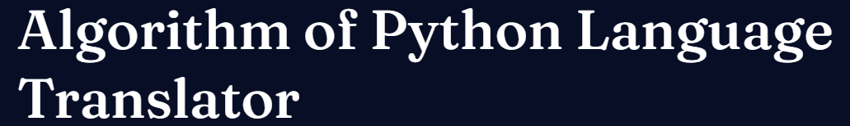
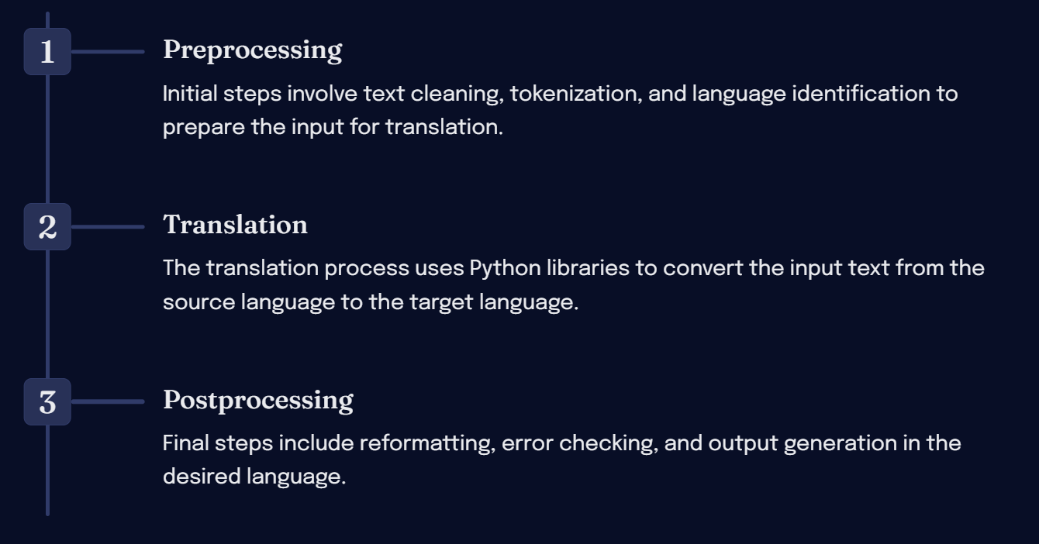

Slide 5

Modules used:
SPEECH RECOGNITION:
The process of enabling a computer to identify and respond to the sounds produced in human speech.
GOOGLE TRANS: multilingual neural machine translation service developed by Google to translate text, documents and websites from one language into another.
PLAYSOUND:The play sound module is a cross platform module that can play audio files. “pure Python, cross platform, single function module with no dependencies for playing sounds.

Slide 6

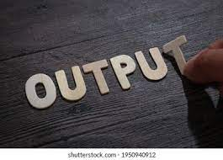
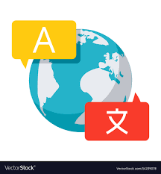
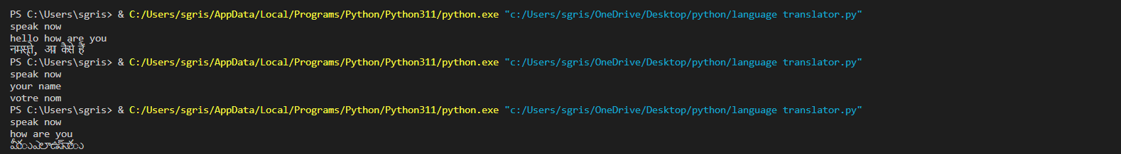

Slide 7
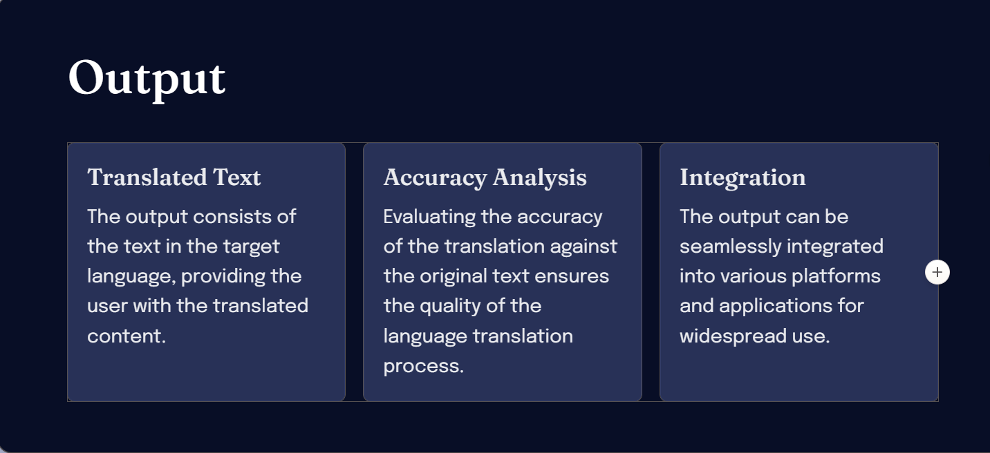
RESULT

Slide 8
